Slide 1
Service principle
The service principal object defines what the app can actually do in the specific tenant, who can access the app, and what resources the app can access. When an application is given permission to access resources in a tenant (upon registration or consent), a service principal object is created

Slide 2
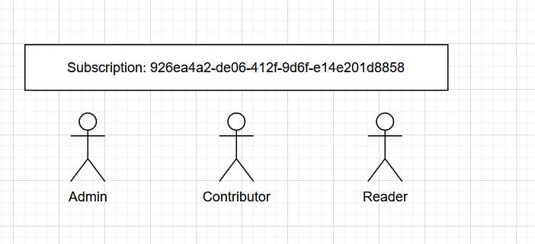
Service principle

Slide 3
commands
az ad sp create-for-rbac --name <service-principal-name> --role Contributor --scopes /subscriptions/<subscription-id>
az ad sp create-for-rbac --name devserviceprincipal --role Contributor --scopes /subscriptions/926ea4a2-de06-412f-9d6f-e14e201d8858

Slide 4
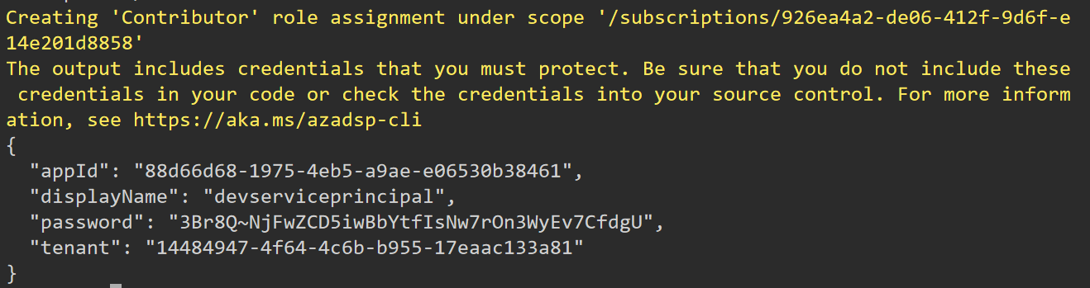
Expected output

